Slide 1

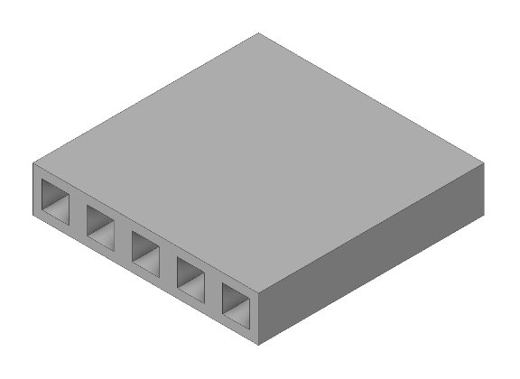
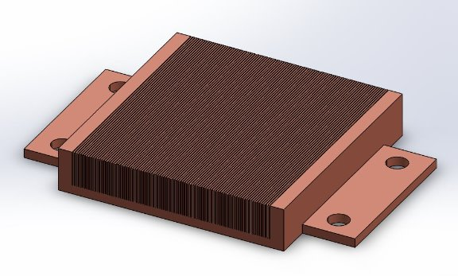
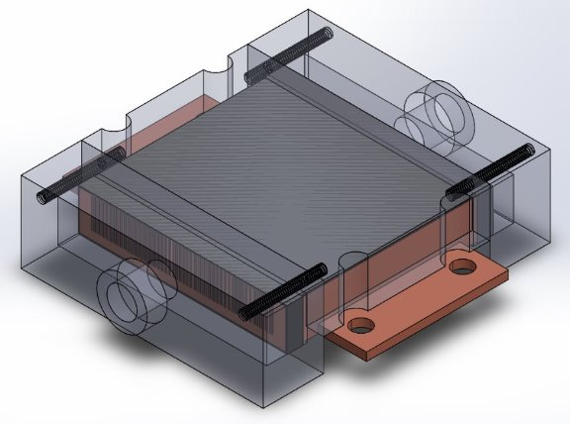
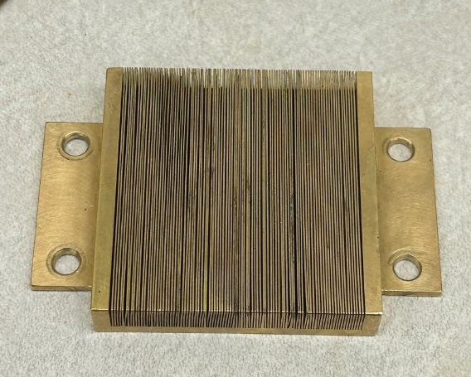
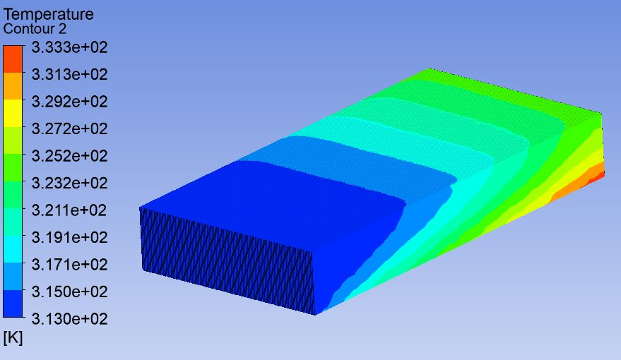
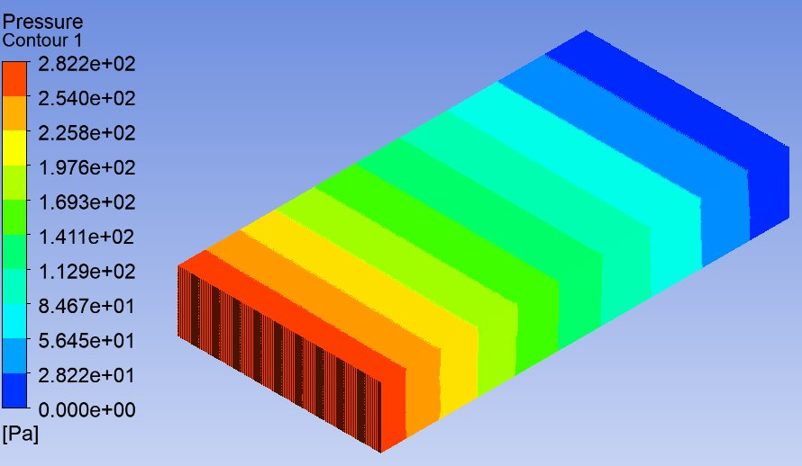
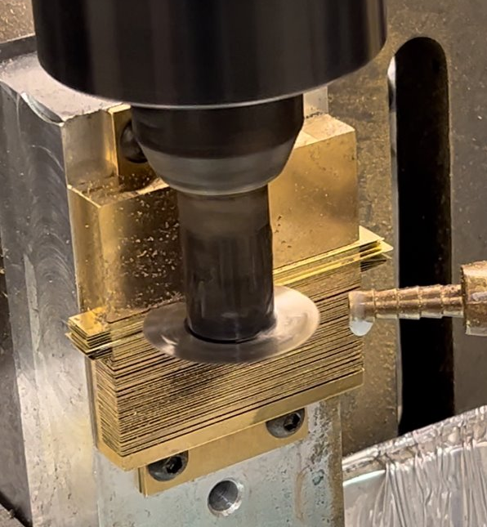
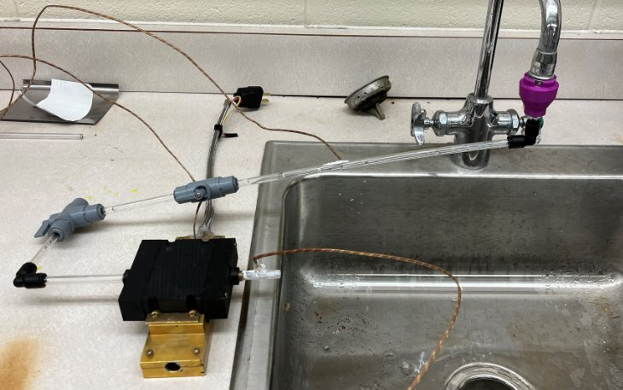




Bifacial Cold Plates for High Power Servers
Project Introduction:
Our team has simulated, built, and tested a new cold plate that will convert Microsoft's new super server from air to liquid cooling. The goal of this new cold plate is to keep the server's case temperature at or below 80°C (176°F). Heat is caused by the server chip that produces 1000W of power. In addition, a variety chips on the other side of the motherboard will be producing a total of 114W of power.
Constraints:
Structure and Sizing
Ideal material is pure copper
Server chip is 50mm x 50mm
Keep-out zone (KOZ) of 65mm x 65mm
Temperature
Inlet temperature of 40°C
Desired case temperature less than 80°C
Water Flow
Target of 1.5 lpm per kW
Pressure Drop
Less than 1 bar
Initial Cold Plate Design
Final Cold Plate Design
Full Assembly Including Manifold
Manufactured Cold Plate
ANSYS Simulations (Half Cold Plate):
Simulation Process:
Simulations were conducted in Ansys Fluent to ensure that our design would satisfy the given constraints and the case temperature would be sufficiently cool. The heat flux was determined to be constant for the simulations. Therefore, the cold plate model was halved to keep the mesh finer and the simulations more efficient. These models are for the ideal material for this application: copper. The resulting maximum temperature for this design is 60.3°C, which meets the given case temperature threshold of 80°C. Bottom side cold plate simulations are also computed.
Temperature Gradient
Pressure Drop Gradient
Manufacturing and Testing:
Manufacturing and Testing Process:
During our team's research into manufacturing processes and the cost of copper, we concluded that our final design could not be a copper manufactured cold plate within our budget. Skiving, the ideal manufacturing process that would have involved "folding" copper from a block to create the fluid channels, was not available in our machine shop. Therefore, we had to find a more machinable material that allowed for channels to be cut. Brass allowed for this, but thermal performance was less optimal.
Once the prototype was manufactured, our testing station was assembled. A 1000W heater is inserted into a machined brass block that simulates the chip in the server. A flow meter is used to ensure the sink is at the target 1.5 lpm. Thermocouples are used to measure fluid and case temperatures.
Manufacturing of Cold Plate
Testing Apparatus
Conclusions:
Although our team was able to design and simulate an ideal copper cold plate, we were only able to manufacture and test a brass rendition due to budget.
Special thanks to the Microsoft team:
Kathryn Oseen-Senda
Oscar Moguel
Courtney Huddleston
Source: Bergman, T. L., & Incropera, F. P. (2011). Fundamentals of heat and mass transfer (Seventh edition.). Wiley.
Faculty Mentor: Dr. Shalabh C. Maroo
Jeremy Kang
Matthew MacFarlane
Evan Tulsky

